Slide 1
Biodiversity and its Interface with Indigenous Culture, Languages, and Well Being
Dr. Anabel Benjamin Bara
Dr. Vincent Ekka
Prof. Virginius Xaxa
Prof. Bipin Jojo
India Indigenous Peoples

Slide 2
Introduction
In general, our surrounding comprises the human world, the natural world, and the supernatural world.
The human world comprises relations among human beings.
The natural world consists of nature in the form of rivers, air, mountains, forests, land, animals, birds, species, microorganisms, biodiversity, environment, etc.
The supernatural world is the world of invisible forces, gods and spirits.
Indigenous peoples look at these in a holistic manner.

Slide 3
The interaction between them gives rise and meaning to the unique cultures and languages leading to the well-being of the people.

Slide 4
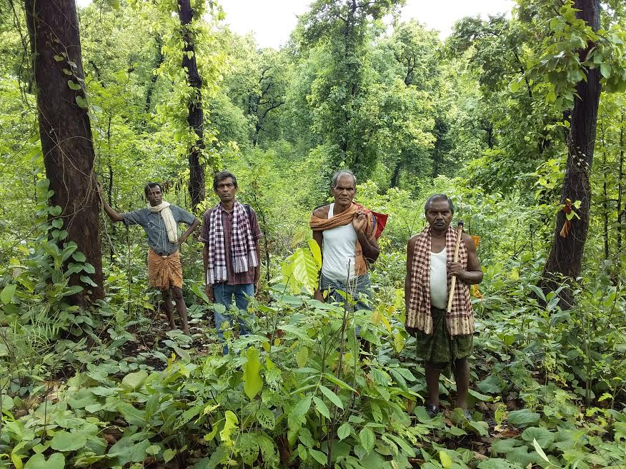

Slide 5
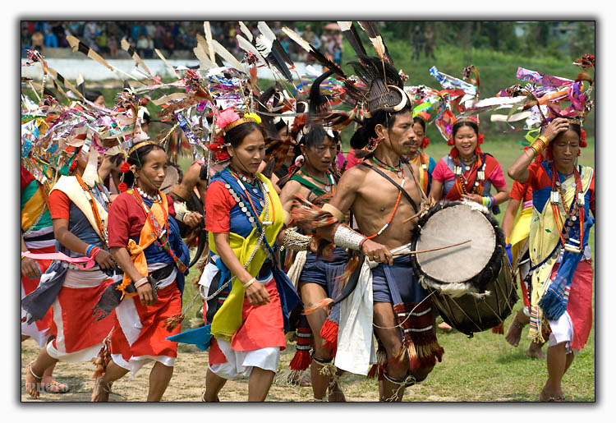

Slide 6
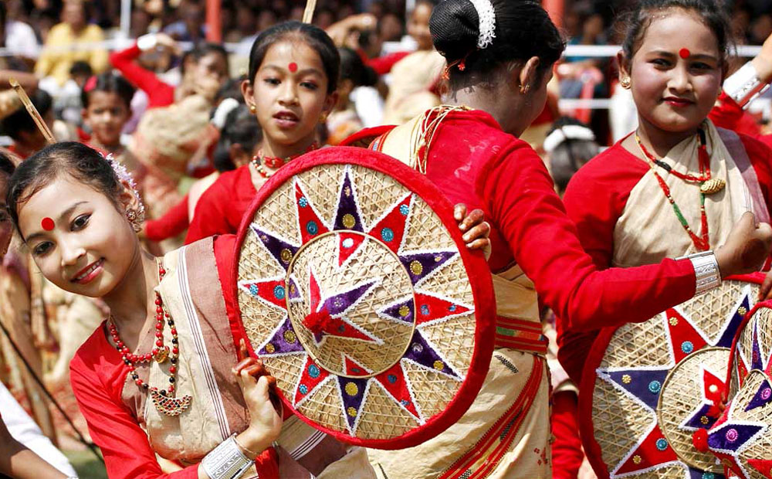

Slide 7
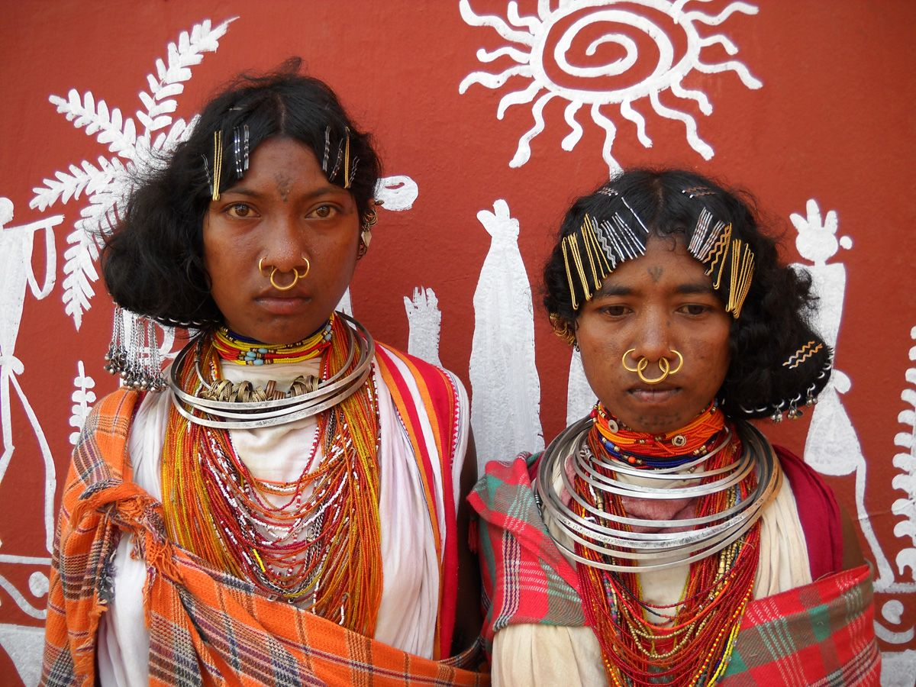

Slide 8
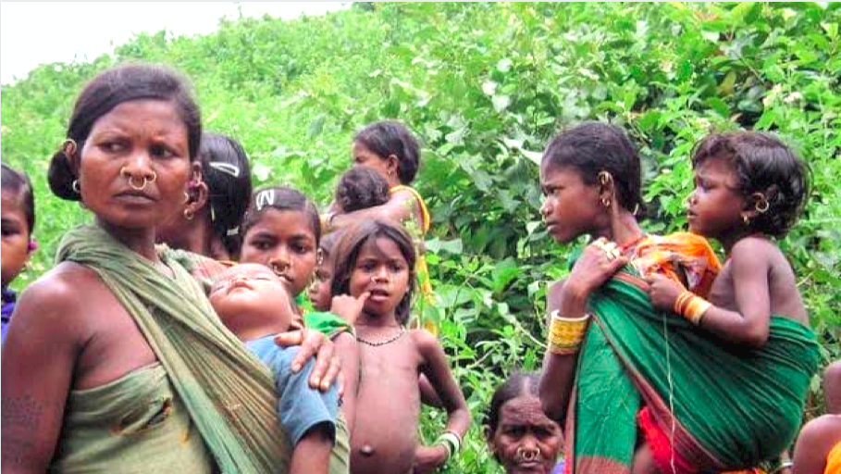

Slide 9
‘I am because You are, and You are because I am’

Slide 10
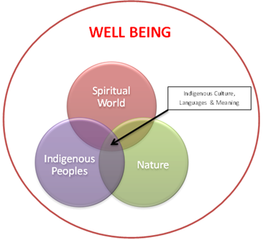

Slide 11
Issues and Problems
However, encroachments by outsiders (non-tribals, corporates, and governments etc.) in the tribal territory have impacted the life, biodiversity, ecology, well-being, environment, and climate of that area.
Mining and infrastructure constructions, in the name of development projects, and occupying land in the name of the settlement and social causes, had a severe impact on the life of indigenous peoples.
All these have led to the displacement of tribals which have led to the slow demise of culture and languages.
Impact of Political, Economic, Social, and Technological (PEST) factors have also impacted the well being of Tribal communities.

Slide 12
Disruption of forests, water bodies, land, ecology, biodiversity, etc. also leads to disruption of indigenous culture, languages and well being.

Slide 13
Objectives
Collaborating with indigenous communities and peoples to understand the relationship between the indigenous culture, languages, nature, and the world of spirits.
To document indigenous culture and endangered indigenous languages and examine the factors that have contributed to it and,
To work out strategies and plans to restore and revitalize the indigenous languages and culture not only through the academic programme but also through the attempts at restoration and revitalization of their relations with natural environment and economic life support systems.
To involve indigenous peoples in transformative initiatives.

Slide 14
Research Methodology
The methodology of the research will evolve with the indigenous communities through consultations and dialogues.
The Communities will not be the subjects of research but the joint collaborators and authors of the research processes and the outcomes.
It will use some mixed ethnographic methods and tools like case narratives, group discussions, historiography, immersion technique, indigenous perceptions, participant observation, collecting folk stories, and folk songs.
Indigenous peoples will be in the lead for this project together with the researchers.

Slide 15
Research Team
The research team will comprise indigenous traditional leaders and scholars from the areas of social sciences, development studies, tribal studies, and those interested and engaged in, studies of the environment, ecology, climate change, etc.

Slide 16
Research will be done in three Phases

Slide 17
Phase 1
Exploring and Understanding the interrelatedness, interdependence, and interlinkages of nature (biodiversity, ecology, and environment) and the spiritual world on the indigenous peoples’ culture, languages, and overall well-being.
Documenting oral, practical, and written evidences regarding the human-nature interrelations and linguistic evidences.
Understanding how PEST influences and impacts indigenous culture and languages. This assessment will be done with the help of indigenous peoples.

Slide 18
Phase 2
Based on the information and data we would build capacity and awareness about the importance of language and culture among the indigenous communities.
We will conduct participatory research through indigenous leaders and indigenous knowledge holders and find ways to preserve and revitalize culture and languages.
Certain initiatives like digitization of languages, and culture, community radio stations, media channels, websites, publishing books and articles, and networking with the government, non-government and international agencies to revitalize indigenous language and culture.

Slide 19
Phase 3
In this phase, we would like to do policy intervention wherein special laws, budgets, and other resources could be asked from the government.
We would try to include indigenous youths and do mass promotions of indigenous languages and culture through their networks.
We will ask for the recognition of indigenous languages in the 8th schedule of the Constitution of India and the incorporation of indigenous culture and languages in the school curriculum and syllabus.
To make it smoother we would form institutions that could help in the smooth functioning of the initiatives taken. These policy interventions through community leaders could help in driving institutional transformation.

Slide 20
Scope of Research Project
We propose to conduct the research in three zones in India i.e. North East, Central, and South-West.
The regions are selected based on the different geographical locations having different cultures, traditions, and practices.
The scope will cover biodiversity conservation, health, livelihood and indigenous economy, and customary law & governance, culture, and language.

Slide 21
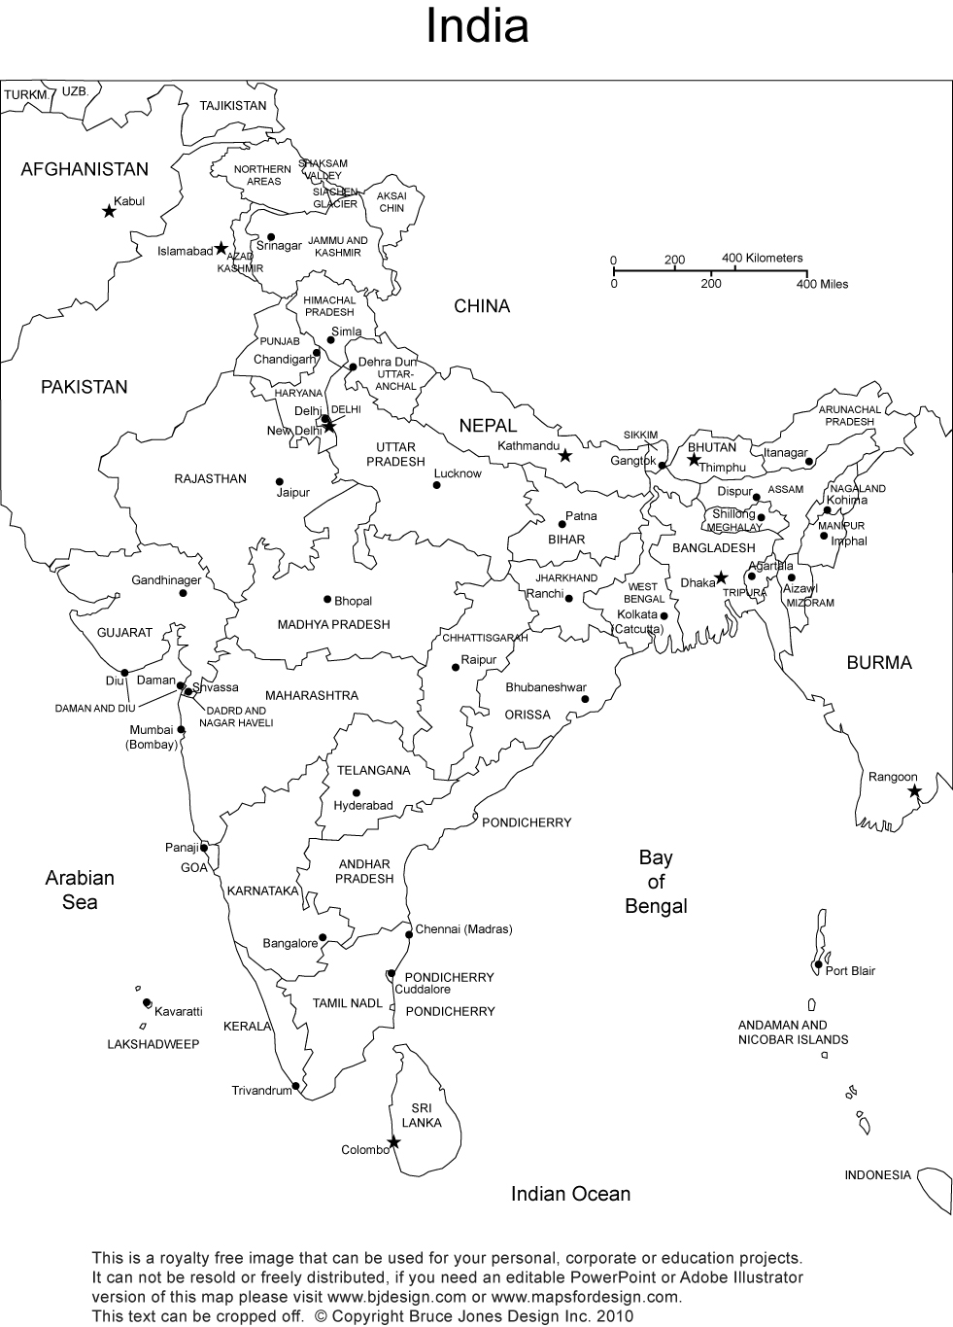

Slide 22
Structure of the Team
Nodal Persons/Agencies (Adv. Nicholas Barla, Dr. Vincent Ekka, and Prof. Bipin Jojo)
Steering Committee Team
Advisory Committee Team
Zonal Lead Researchers (North-East, Central, and South-West)
Theme Specific Co-Lead Researcher
Area Coordinators
Assistant/Associate Researcher
Field investigator, Indigenous Experts, and Community Leaders

Slide 23
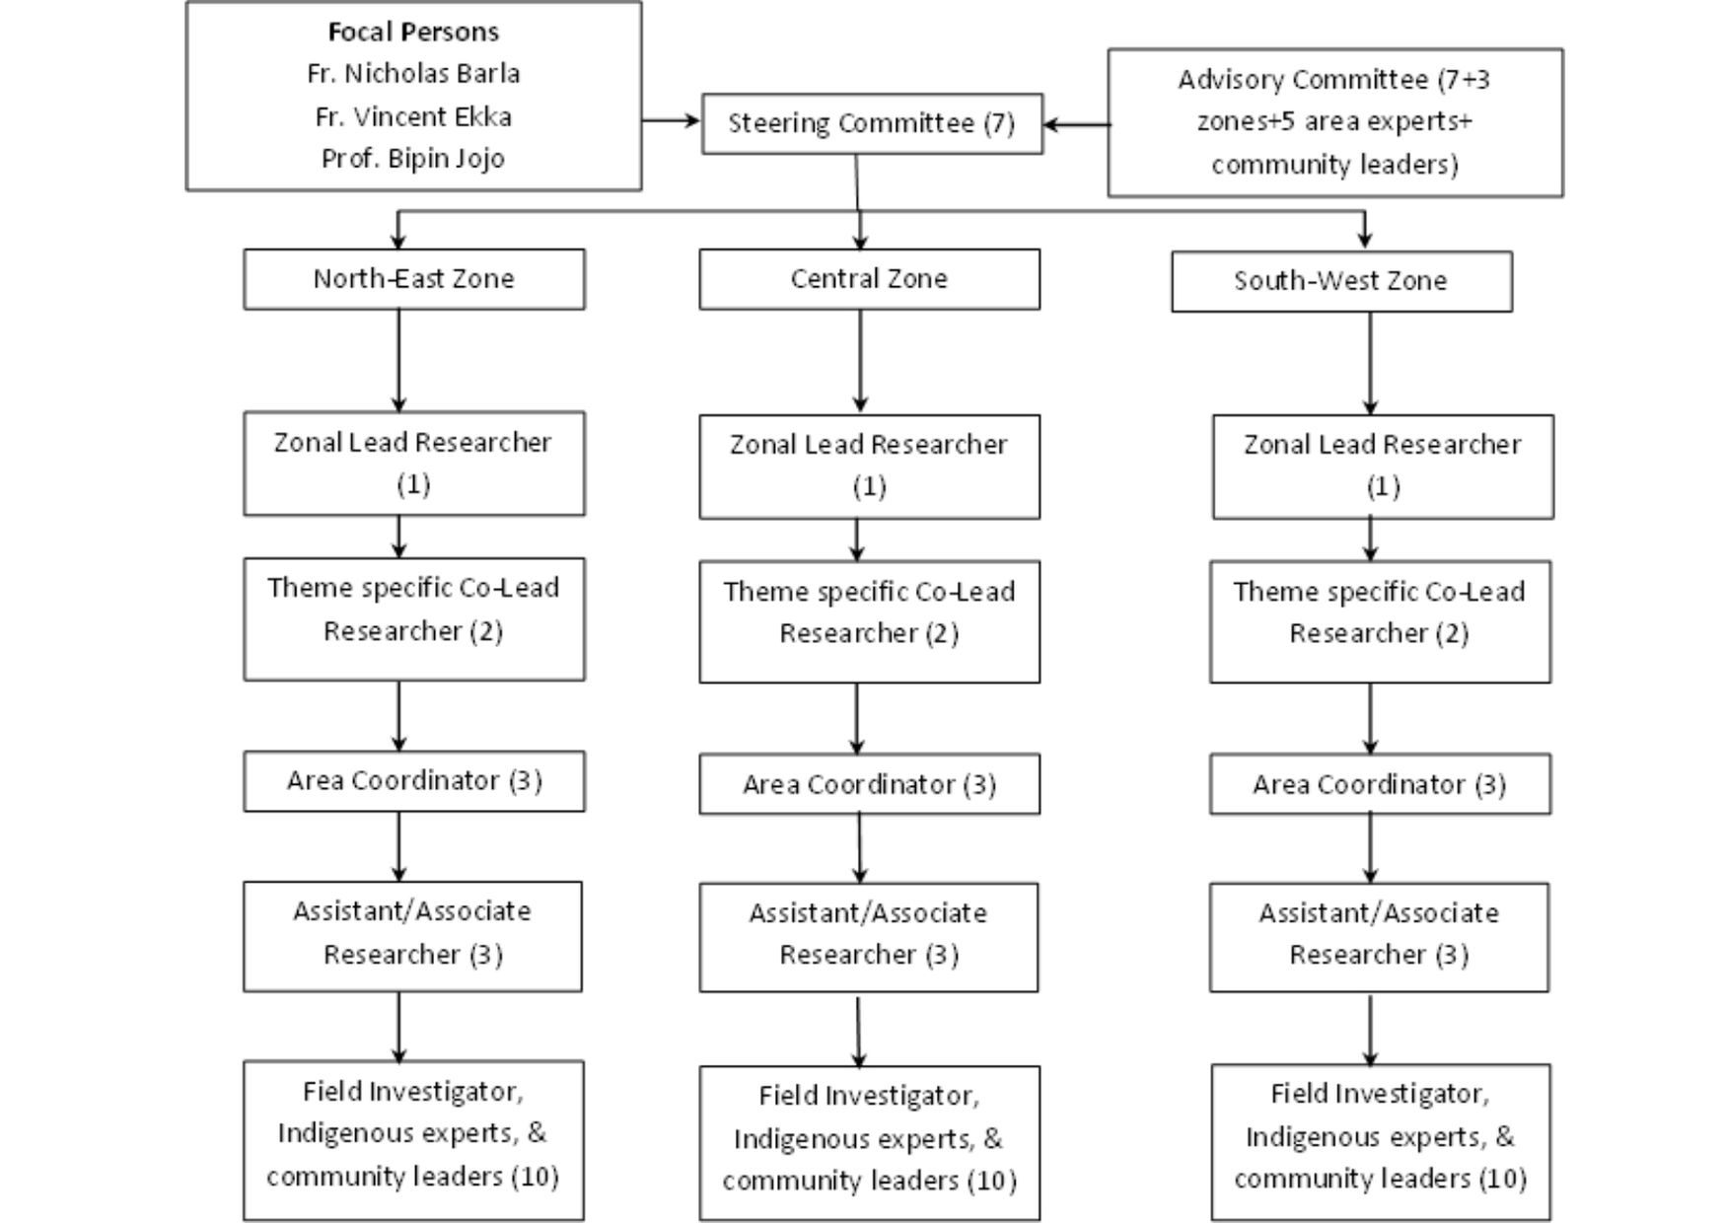
Working Group

Slide 24
Johar

