Slide 1
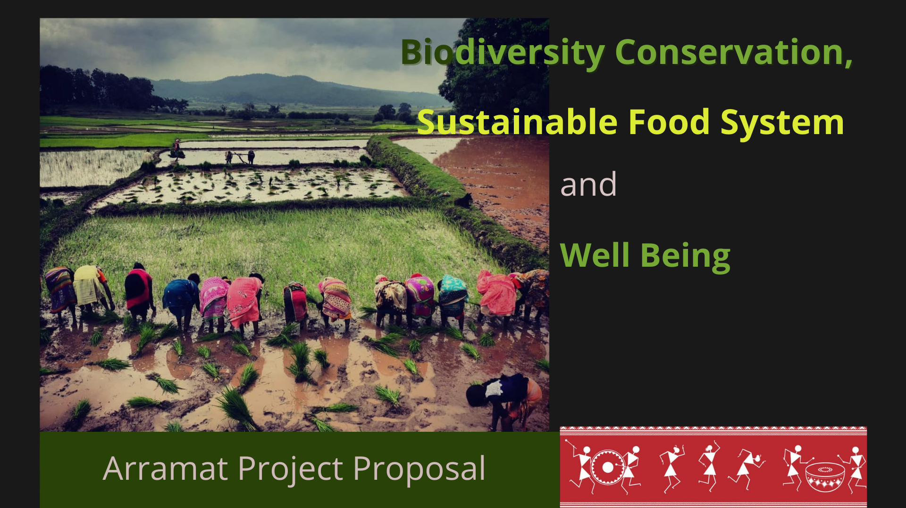

Slide 2
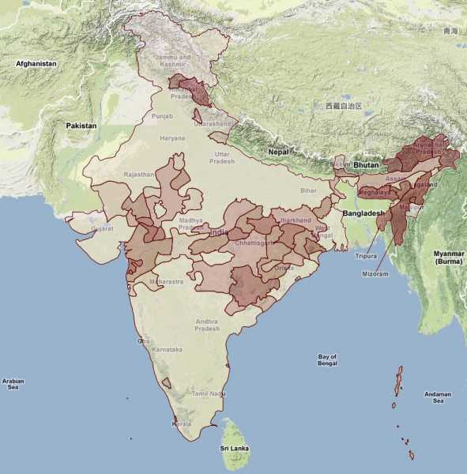
India Indigenous Peoples Map and Forest Map of India

Slide 4
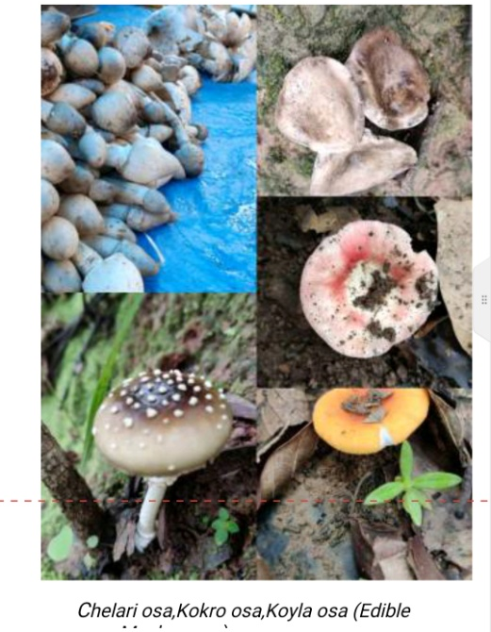
Indigenous scientific knowledge
Modernity as non-science.
Biodiversity extinctions :
Indigenous People have managed to conserve 75 % of Biodiversity in 25 % of Land.
Effect of Modern Agriculture System: 12 Crops supplying 80 percent of diets. With significant ecological impacts.
Agriculture as major cause of Ecological crises.

Slide 5
Indian specificity and Importance of the research
705 different Indigenous communities
Dearth of a holistic research
Absence of Indigenous Perspective in available research
Indigenous people in India have been subjected to multiple conditions under which their potential to sustain and enhance biodiversity has eroded.
Conflict on the idea of Indigenous People
Although this research will be conducted among a few Indigenous communities, this will give us roadmaps and pave ways for further research, and policy framing among the rest of the communities in India.

Slide 6
Research Objectives
(i) To understand the relationship between conservation of biodiversity, ecosystem, and indigenous communities in tribal regions of India,
(ii) To focus on food systems and ways they are organized and produced and their role in sustaining of biodiversity and ecological balance, and
To evolve strategies to restore and revitalize the indigenous food system through revitalizing interrelations between indigenous communities and ecological surroundings.

Slide 7
Research Questions
What are the major food systems of indigenous people in India? What are the overlapping and also unique food systems among them?
How different state policies affect Indigenous people’s traditional food system in India. What is the major effect of modernity, displacement, erosion of rights, etc.
What are the recent transformations in indigenous food systems? How do these affect the sustainable indicators?
What contributions the indigenous food system can offer in the existing knowledge and practices of the sustainable food system.
How do Indian indigenous communities differ or match other existing ‘alternative food systems’ such as agro-ecology, food-sovereignty movements, etc?
What are the ways of the revitalization of the ‘indigenous food system’ and in what ways this advocacy can leave a lasting impact on environmental sustainability in general?

Slide 8
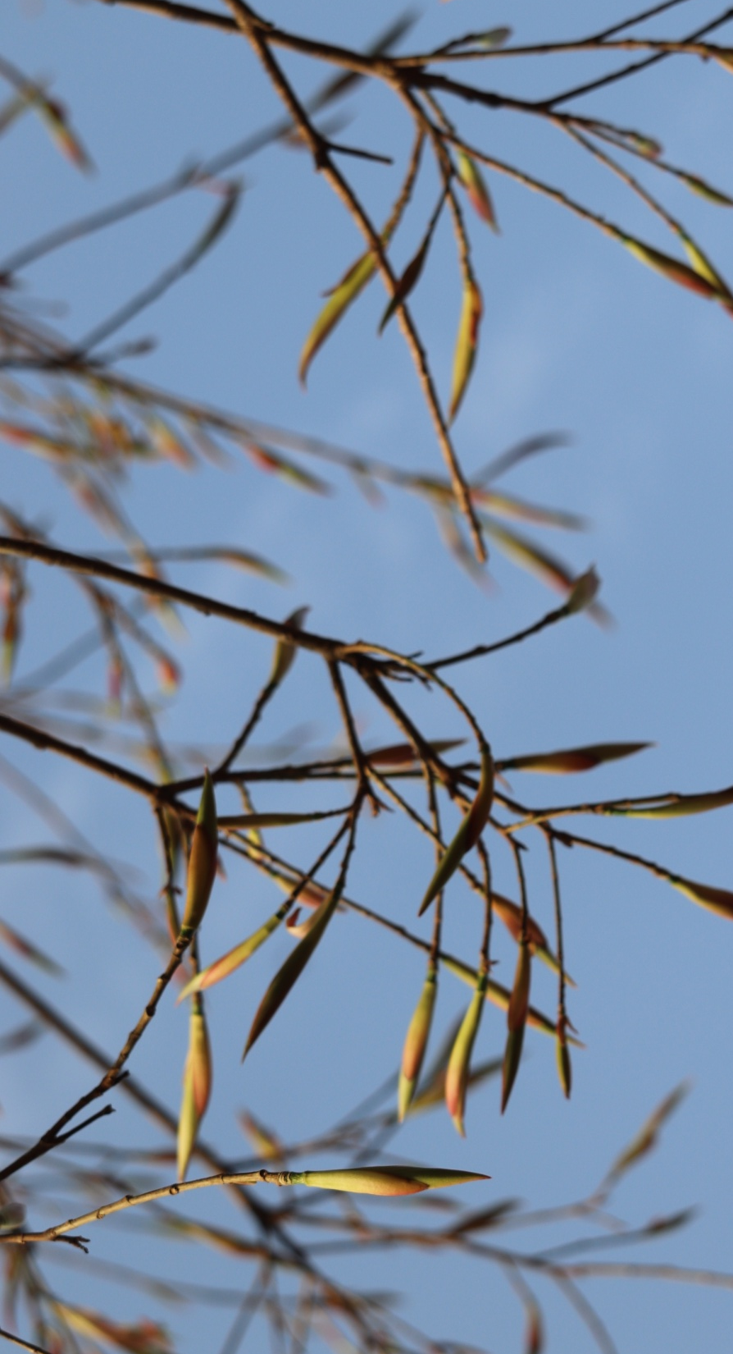

Slide 9
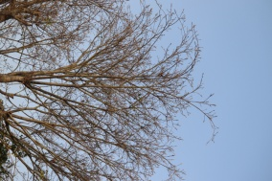
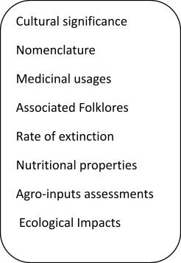
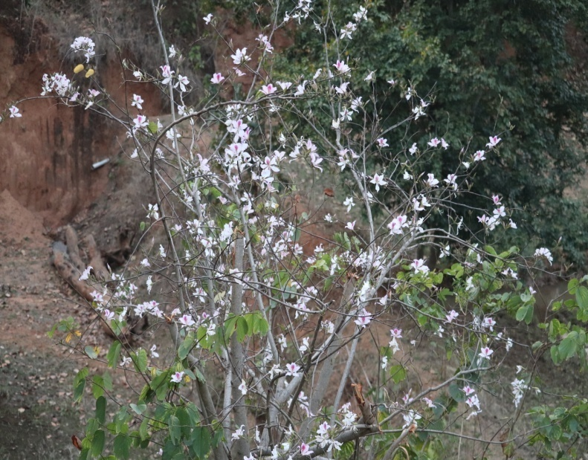
Mushrooms

Slide 10
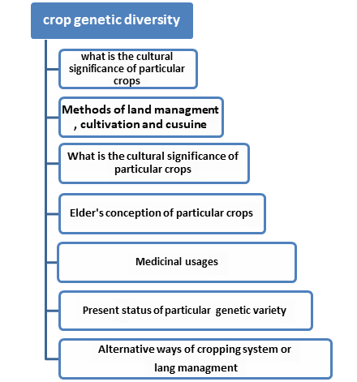
Food Crop Inquiry

